Slide 1
User Manual
Required Software Installation
Board and Connectivity
Running my setup (Streaming my data)

Slide 2
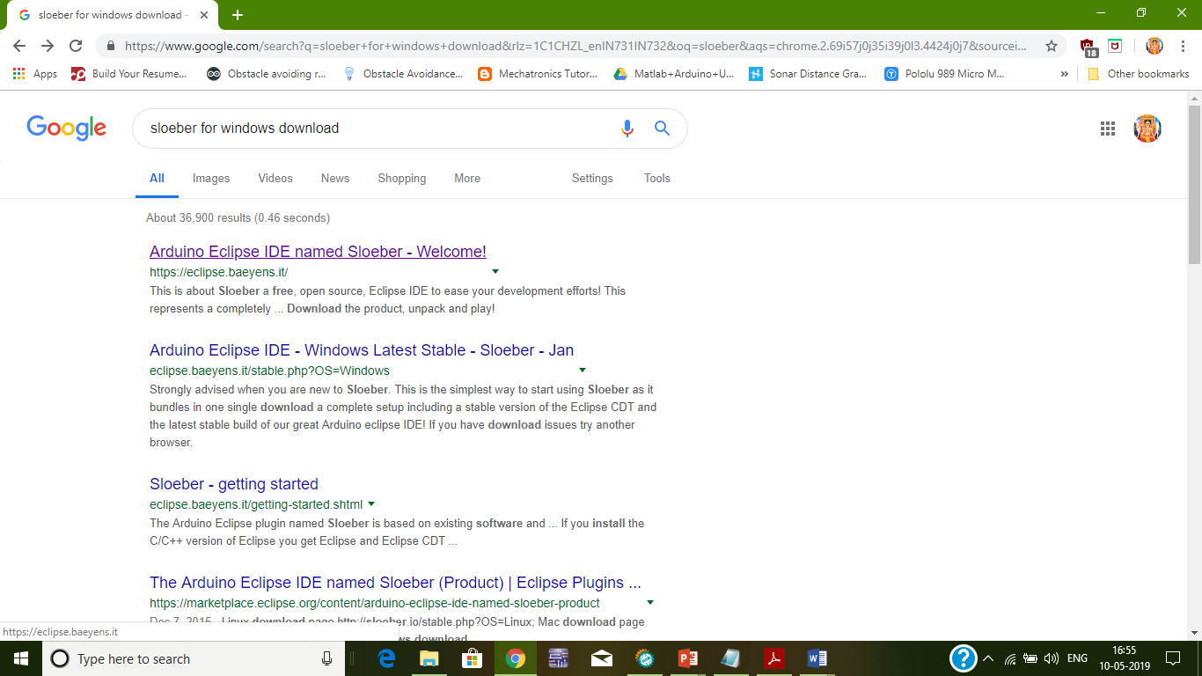
Software Installation
Installing the software: Follow the instructions
Search for the Sloeber on the web as shown

Slide 3
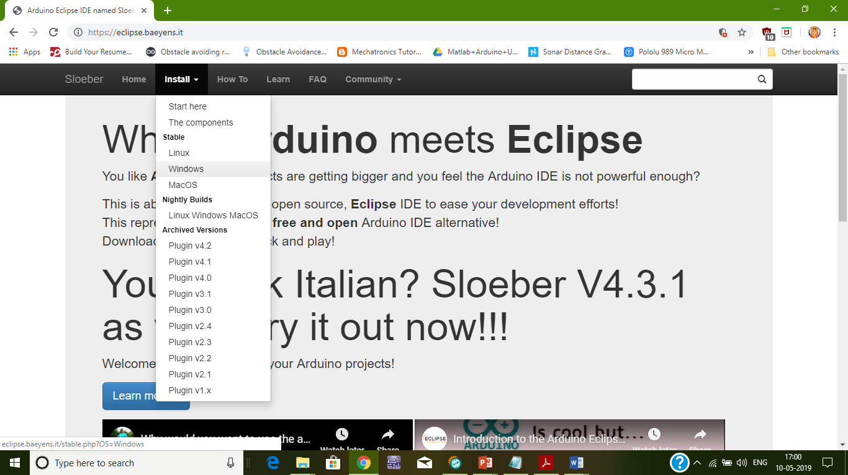
Choose the required option as shown

Slide 4
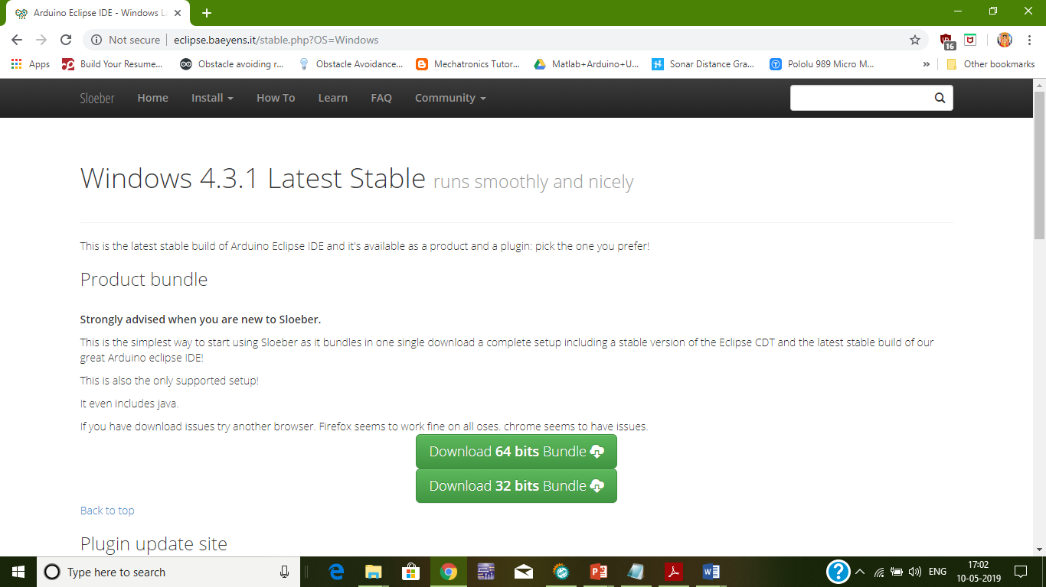
Click on the Download bundle option( depends on your system configuration)

Slide 5
After downloading:
The files needs to be extracted into a folder.
Extracted files now stored, check for the .exe file and run it on your system. This is the way to install it.
After installing open the Sloeber IDE.
Create a new project.
Create new File and code the required(usage of c/c++ can be done).
Save the file.

Slide 6
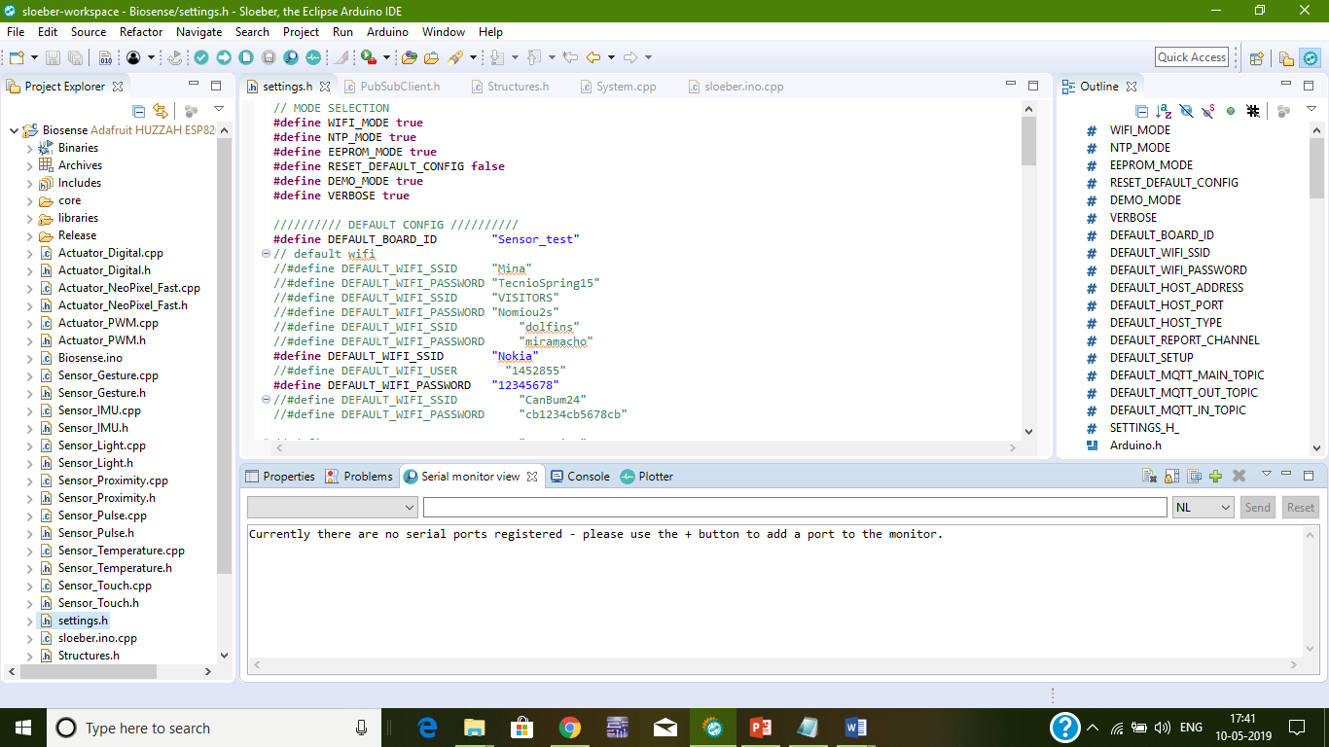
Before running, the interface looks like shown below.

Slide 7
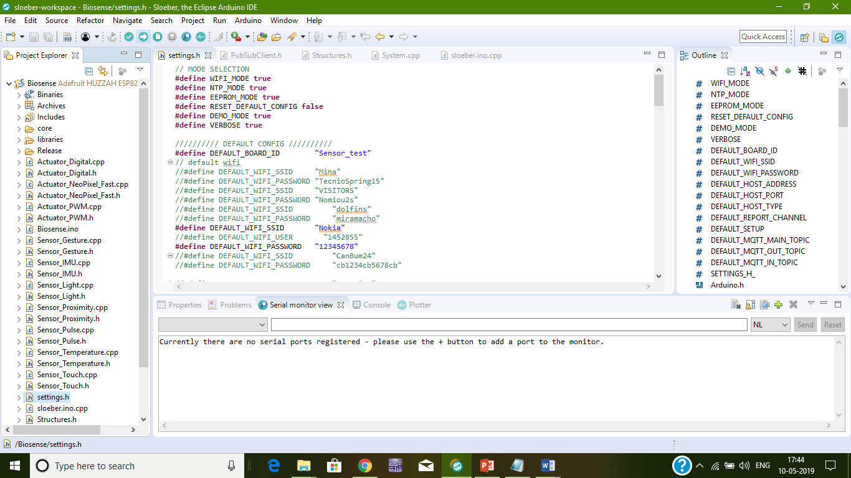
After the code is ready, connect the board to one of the COM ports of your system and click the upload button as shown below.
Upload Button

Slide 8
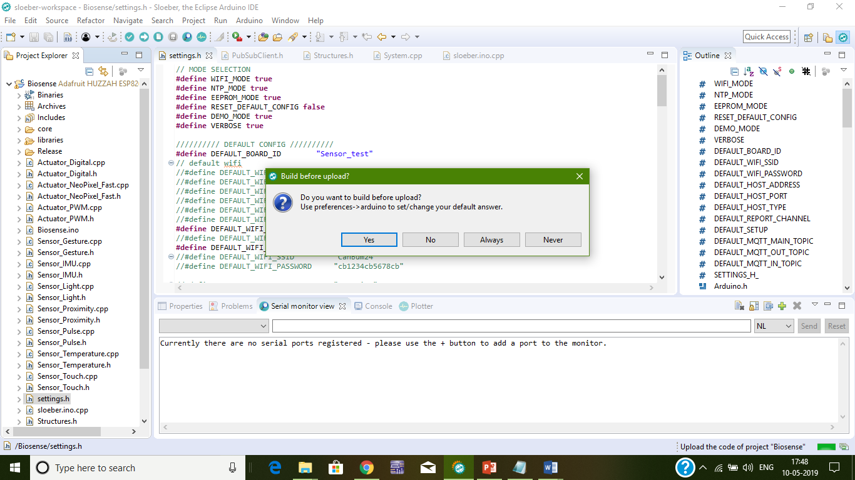
Upload the code and press yes as shown below.

Slide 9
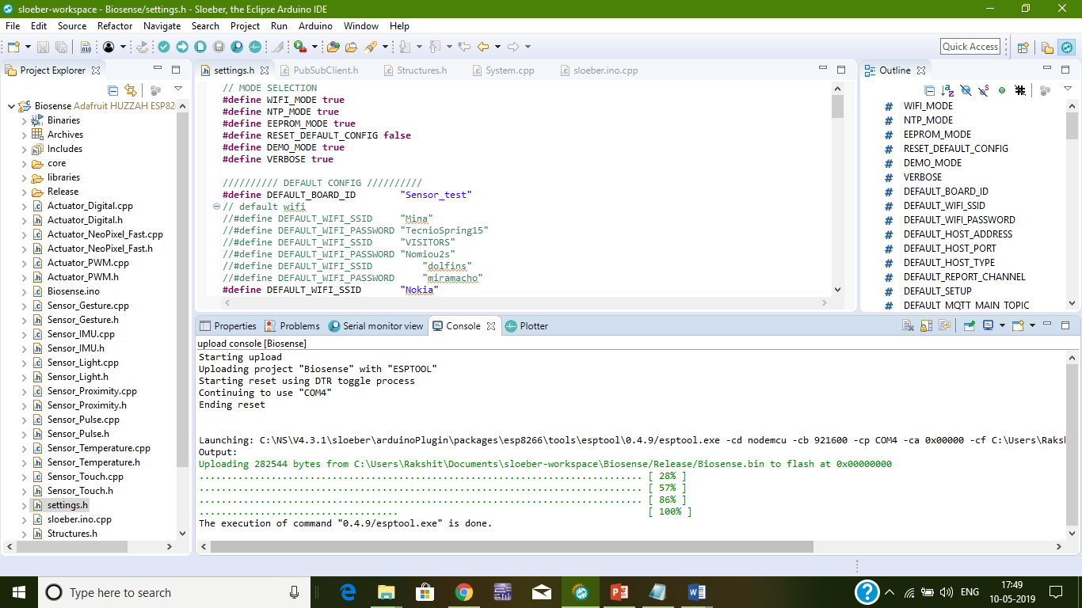
After uploading the console looks like shown below. The 100% represents the code is debugged and successfully uploaded without any errors

Slide 10
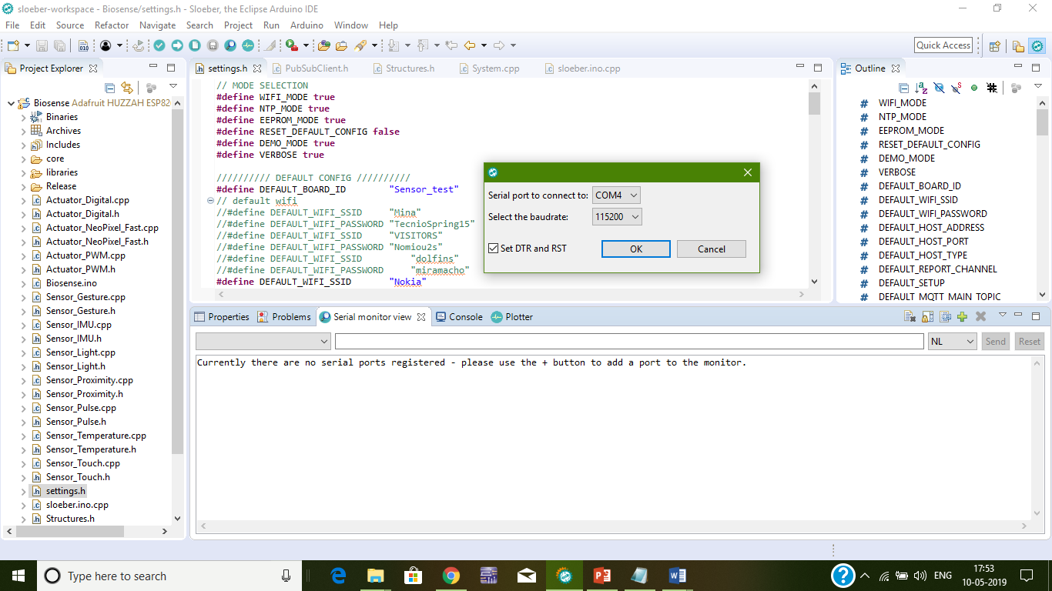
Switch to the serial monitor and press the plus button so as to configure the board into its respective COM Port , and also set the baud rate.
Plus Button

Slide 11
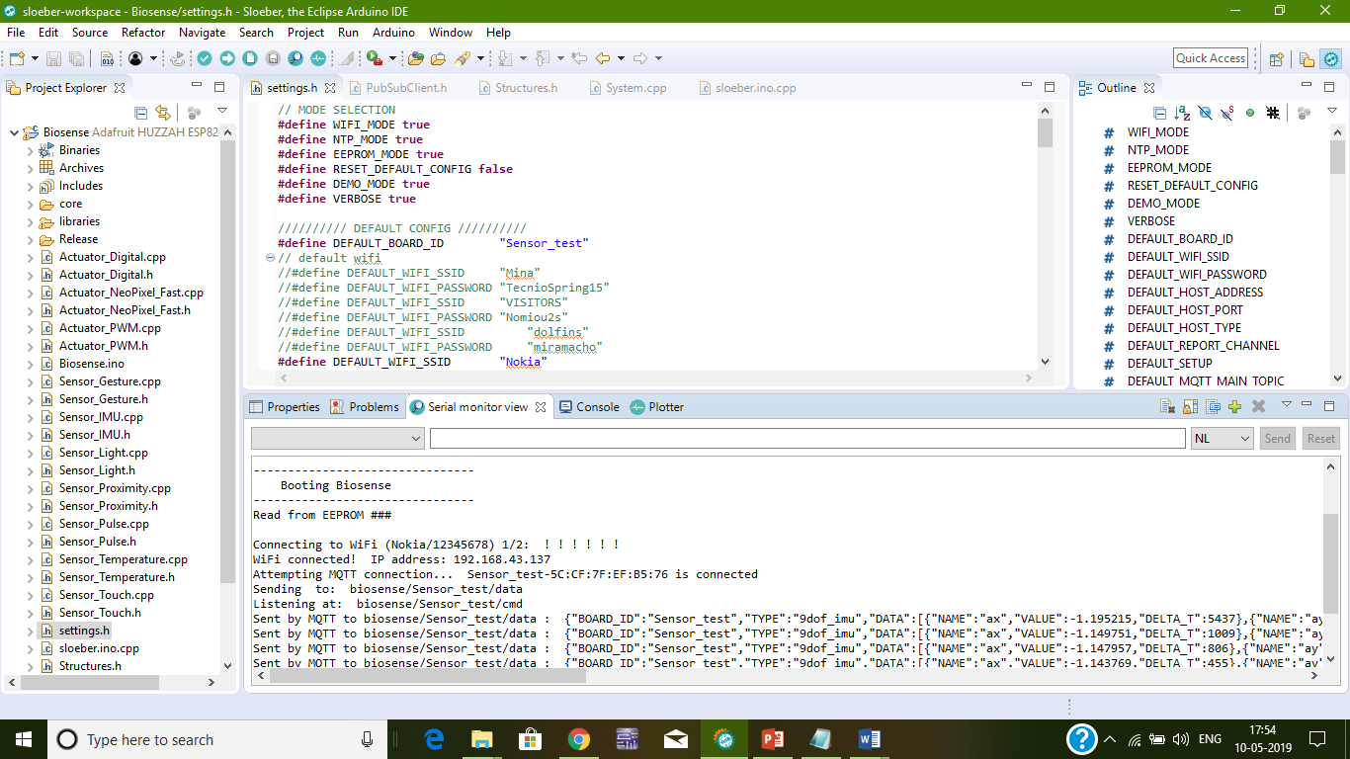
Once the setting is done, the board tries to connect to the server through the wifi network specified and displays a message “Connected”. The data is now streamed successfully into the server

Slide 12
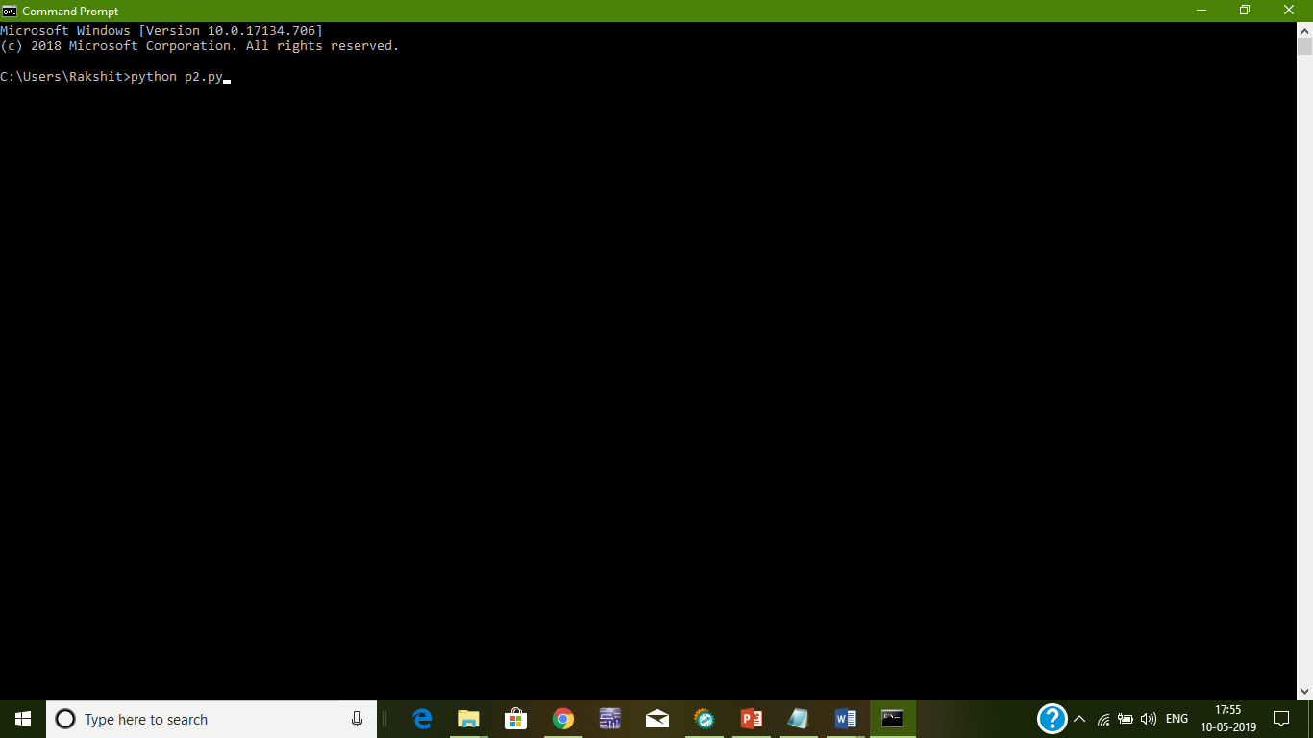
Now, to access data from the server; open command prompt or terminal, and run the code written to access data from server(here my python file named p2 contains the code , so I am running it.)

Slide 13
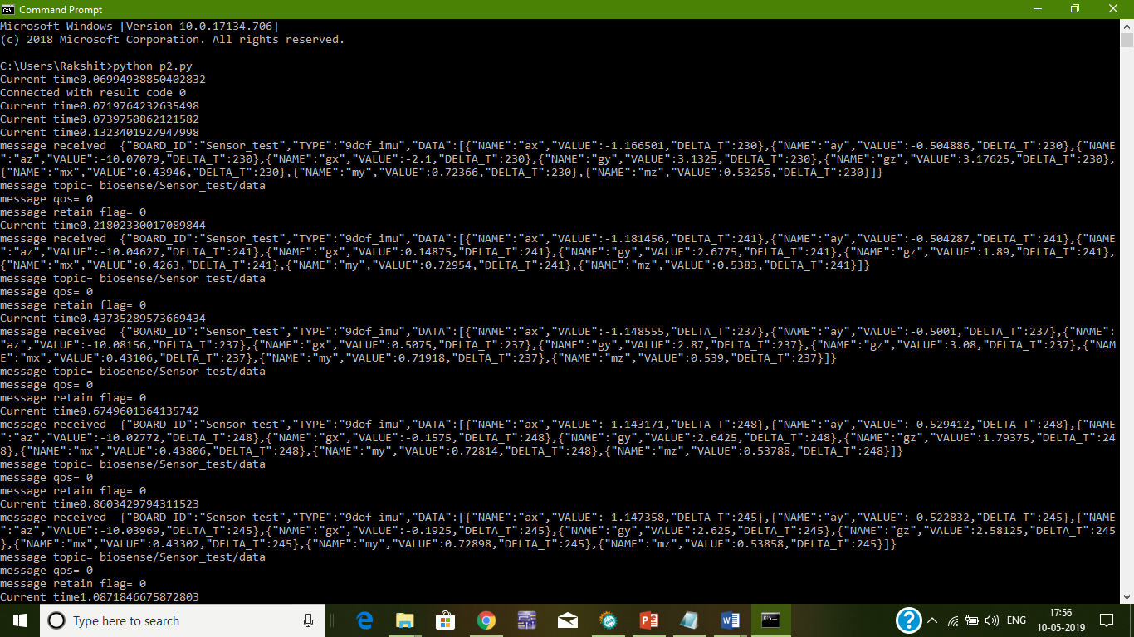
Once the code is ran, the data is accessed and the stream of data is displayed there itself.

